Slide 1
SS ZG 526: Distributed Computing
Grid Computing
Chittaranjan Hota
Professor, Dept. of Computer Sc. & Information Systems
BITS, Pilani Hyderabad Campus, Hyderabad
hota@hyderabad.bits-pilani.ac.in

Slide 2

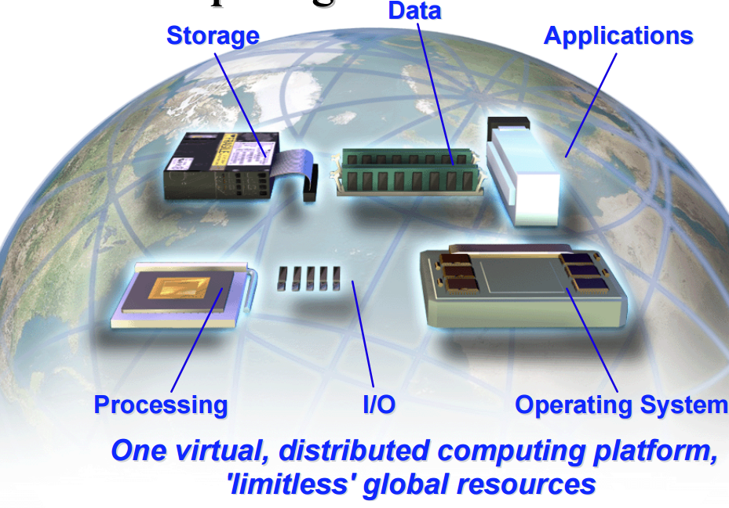
Grid Architecture and Service Modelling
Grid is a metacomputing architecture that brings together PC’s, workstations, server clusters, super computers, PDAs, etc. to form a large collection of compute power, storage power and network resources to solve large scale computing problems.
Birla Institute of Technology and Science, Pilani (Deemed University)

Slide 3
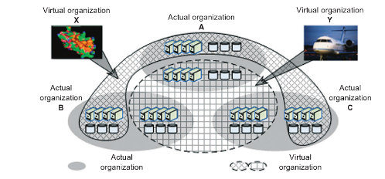

Virtual organizations
Birla Institute of Technology and Science, Pilani (Deemed University)

Slide 4
Grid Service Families
Computational Grids:
Distributed Supercomputing (parallel application execution on multiple machines).
Data Grids:
Provides a way to solve large scale data management problems.
Information or Knowledge Grids:
Dedicated to knowledge management and distributed ontology processing.
    Semantic Grids
Business Grids (IBM Websphere, Microsoft .NET, …)
Birla Institute of Technology and Science, Pilani (Deemed University)

Slide 5

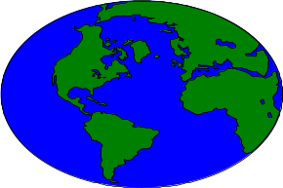
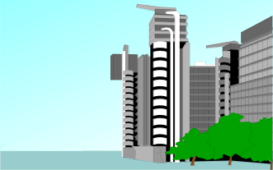



Scalable Computing
PERFORMANCE
+
Q
o
S
2100
2100
2100
2100
2100
2100
2100
2100
2100
Administrative Barriers
Individual
Group
Department
Campus
State
National
Globe
Personal Device
SMPs or SuperComputers
Local
Cluster
Enterprise
Cluster/Grid
Global
Grid
Inter Planet
Grid
SS ZG 526: Distributed Computing
Birla Institute of Technology and Science, Pilani (Deemed University)

Slide 6
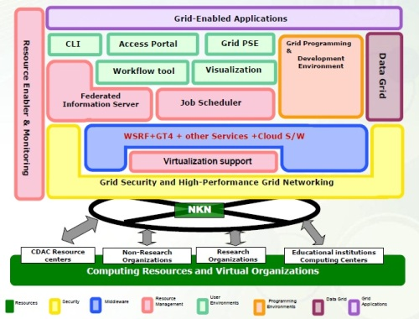

GRID GARUDA
The total computational resources available today on Garuda are approximately 65 Teraflops.
GRID GARUDA initiative is a collaboration of the Scientific, Engineering and Academic Community to carry-out research and experimentation on a nationwide grid of computational nodes, mass storage that aims to provide the distributed data and compute intensive High Performance Computing solutions for the 21st century.
Source: http://nkn.in/garudaoverview.php
Birla Institute of Technology and Science, Pilani (Deemed University)

Slide 7
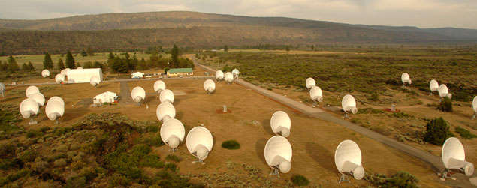
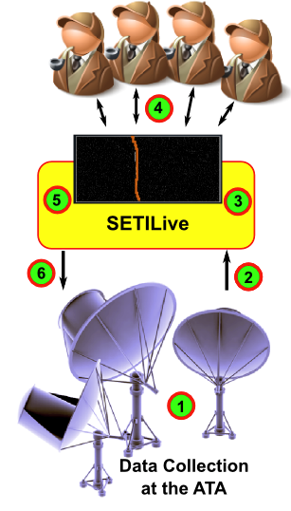

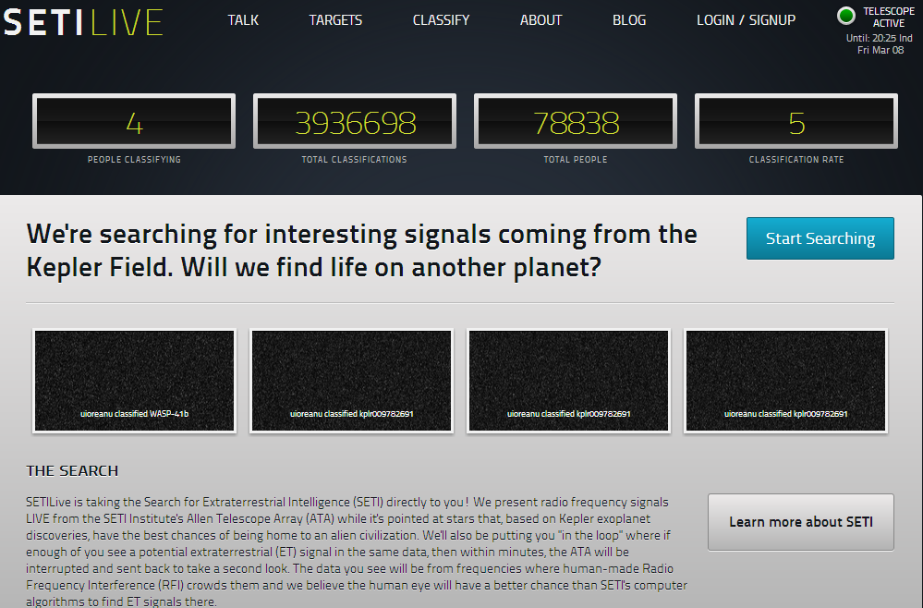
SETI.com
Allen Telescope Array
Birla Institute of Technology and Science, Pilani (Deemed University)

Slide 8

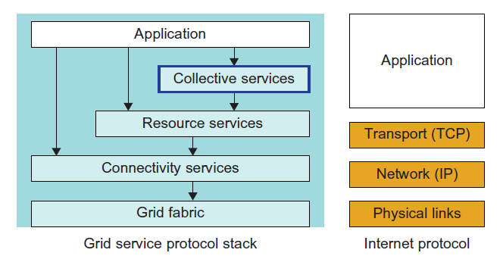
Grid Service Protocol Stack
Physical virtual networks
Network links virtual private channels
Birla Institute of Technology and Science, Pilani (Deemed University)

Slide 9

CPU Scavenging and Virtual Supercomputer
CPU Scavenging :
It is the Concept of creating a grid from the set of unused resources in a network of computers.
Virtual Supercomputers:
Virtual grids are built over a large number of desktop computers by using their free cycles during inactive usage periods. These virtual grids are called as virtual supercomputers.
Grid Resource Aggregation
Birla Institute of Technology and Science, Pilani (Deemed University)

Slide 10

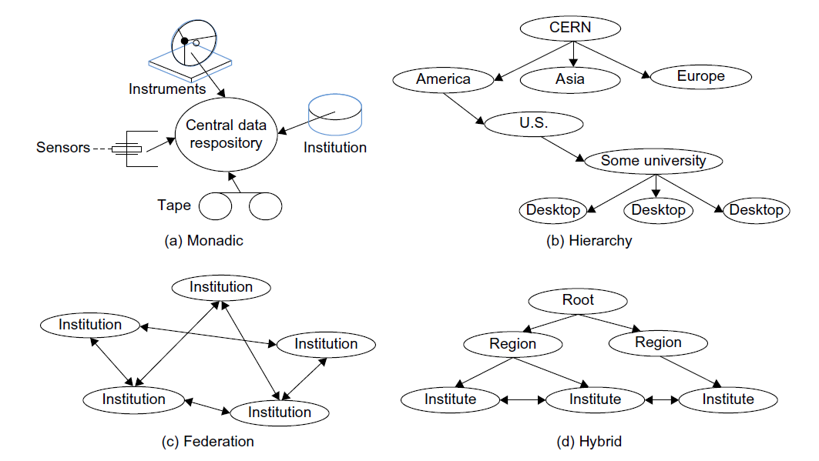
Four architectural models for building a data grid
Birla Institute of Technology and Science, Pilani (Deemed University)

Slide 11

Open Grid Services Architecture(OGSA)
Developed by the Global Grid Forum to define a common, standard, and open architectures for Grid-based applications.
  Provides a standard approach to all services on the Grid.
    VO Management Service.
    Resource discovery and management service:
    Job management service.
    Security services.
    Data management services.
Built on top of and extends the Web Services architecture, protocols, and interfaces.
Birla Institute of Technology and Science, Pilani (Deemed University)

Slide 12

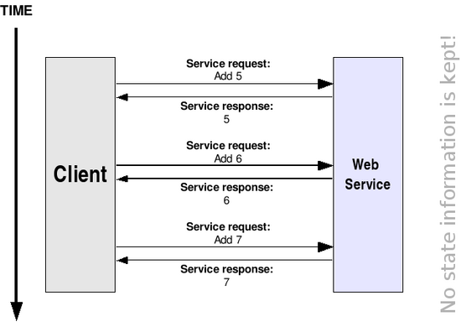
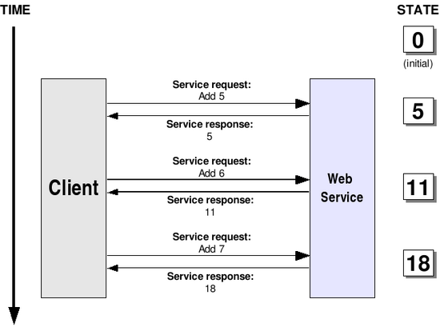
Stateless and stateful web service
Birla Institute of Technology and Science, Pilani (Deemed University)

Slide 13

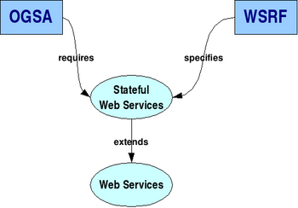
OGSA, WSRF, and Web services
WSRF specifies how to make Web Services stateful
Birla Institute of Technology and Science, Pilani (Deemed University)

Slide 14

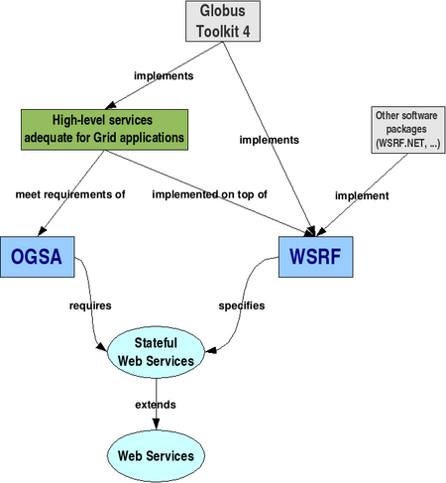
Software for Grid computing
Birla Institute of Technology and Science, Pilani (Deemed University)

Slide 15
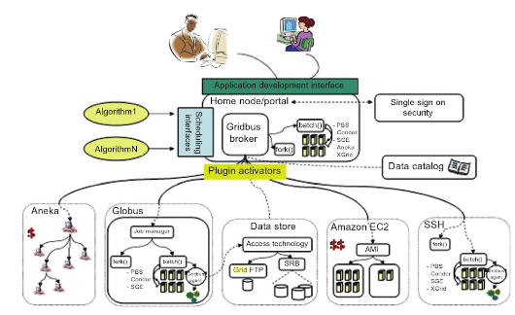

Gridbus Resource broker
Birla Institute of Technology and Science, Pilani (Deemed University)

Slide 16
Next session
Internet of Things (IoT)
Birla Institute of Technology and Science, Pilani (Deemed University)

